Slide 1

2024-25 State of the Division
Dallas Hitt, PhD
Director of School Improvement and
Quality, Policy, and Strategic Planning
“We will know every student.”
Notes:
Good Evening Members of the Board.
Before I begin, I wanted to introduce myself since this is the first time I’ve worked with you in person. My name is Dallas Hitt and I am in my 3rd year of serving ACPS as a director in Strategic Planning.
Prior to joining the team, I spent a decade teaching and researching at the University of Virginia with a focus on the leadership, systems, and structures needed at the state, division, and school levels to catalyze improved student learning. Prior that, I led the turnaround of an urban high school in San Antonio, TX.
I am pleased to be with you tonight to share some highlights from ACPS’s 2024 State of the Division report.
As Dr. McLaughlin indicated, these slides are designed to lift up selected milestones reflecting the key organizational accomplishments from last year while also noting metrics that provide some insight into how well these efforts are working.

Slide 2



Strategic Plan: Learning for All
VALUES
Equity
Excellence
Family and Community
Wellness
GOALS
Thriving Students
Affirming and Empowering Communities
Equitable, Transformative Resources
VISION
Our learners are engaged in authentic, challenging, and relevant learning experiences, becoming lifelong contributors and leaders in our dynamic and diverse society.
MISSION
Working together as a team, we will end the predictive value of race, class, gender, and special capacities for our children’s success through high-quality teaching and learning for all. We seek to build relationships with families and communities to ensure that every student succeeds.
We will know every student.
Notes:
As we get into the report, I want us to center on the Mission because it is so closely aligned with Learning for All- so let’s take a moment to review the mission.
Working together as a team, we will end the predictive value of race, class, gender, and special capacities for our children’s success through high-quality teaching and learning for all. We seek to build relationships with families and communities to ensure that every student succeeds.
We will know every student.

Slide 3
LEARNING FOR ALL
Our Goals
THRIVING
STUDENTS
ACPS will facilitate learning experiences grounded in high expectations, networks of care, and student curiosity to ensure academic and social-emotional development for all students while eliminating opportunity, access and achievement gaps.
AFFIRMING & EMPOWERING COMMUNITIES
ACPS commits to developing a culturally-responsive environment that respects and champions the diversity of life experiences of all stakeholders and supports the physical and mental health of our students, staff and families so they are actively empowered to engage in our school community.
EQUITABLE, TRANSFORMATIVE RESOURCES
ACPS will attract, develop and retain the highest quality staff; develop sustainable and modern facilities, infrastructure and equipment; and distribute all resources in an equitable manner to transform learning experiences and opportunities.
Notes:
These three goals-Thriving Students, Affirming and Empowering Communities, and Equitable and Transformative Resources– are the ways actualize our Mission, Vision and Values.
If we can create the conditions for our students to thrive, our community to be empowered, and use our resources in equitable and transformative ways, we will make progress toward the focus of our Strategic Plan which is LEARNING FOR ALL.

Slide 4
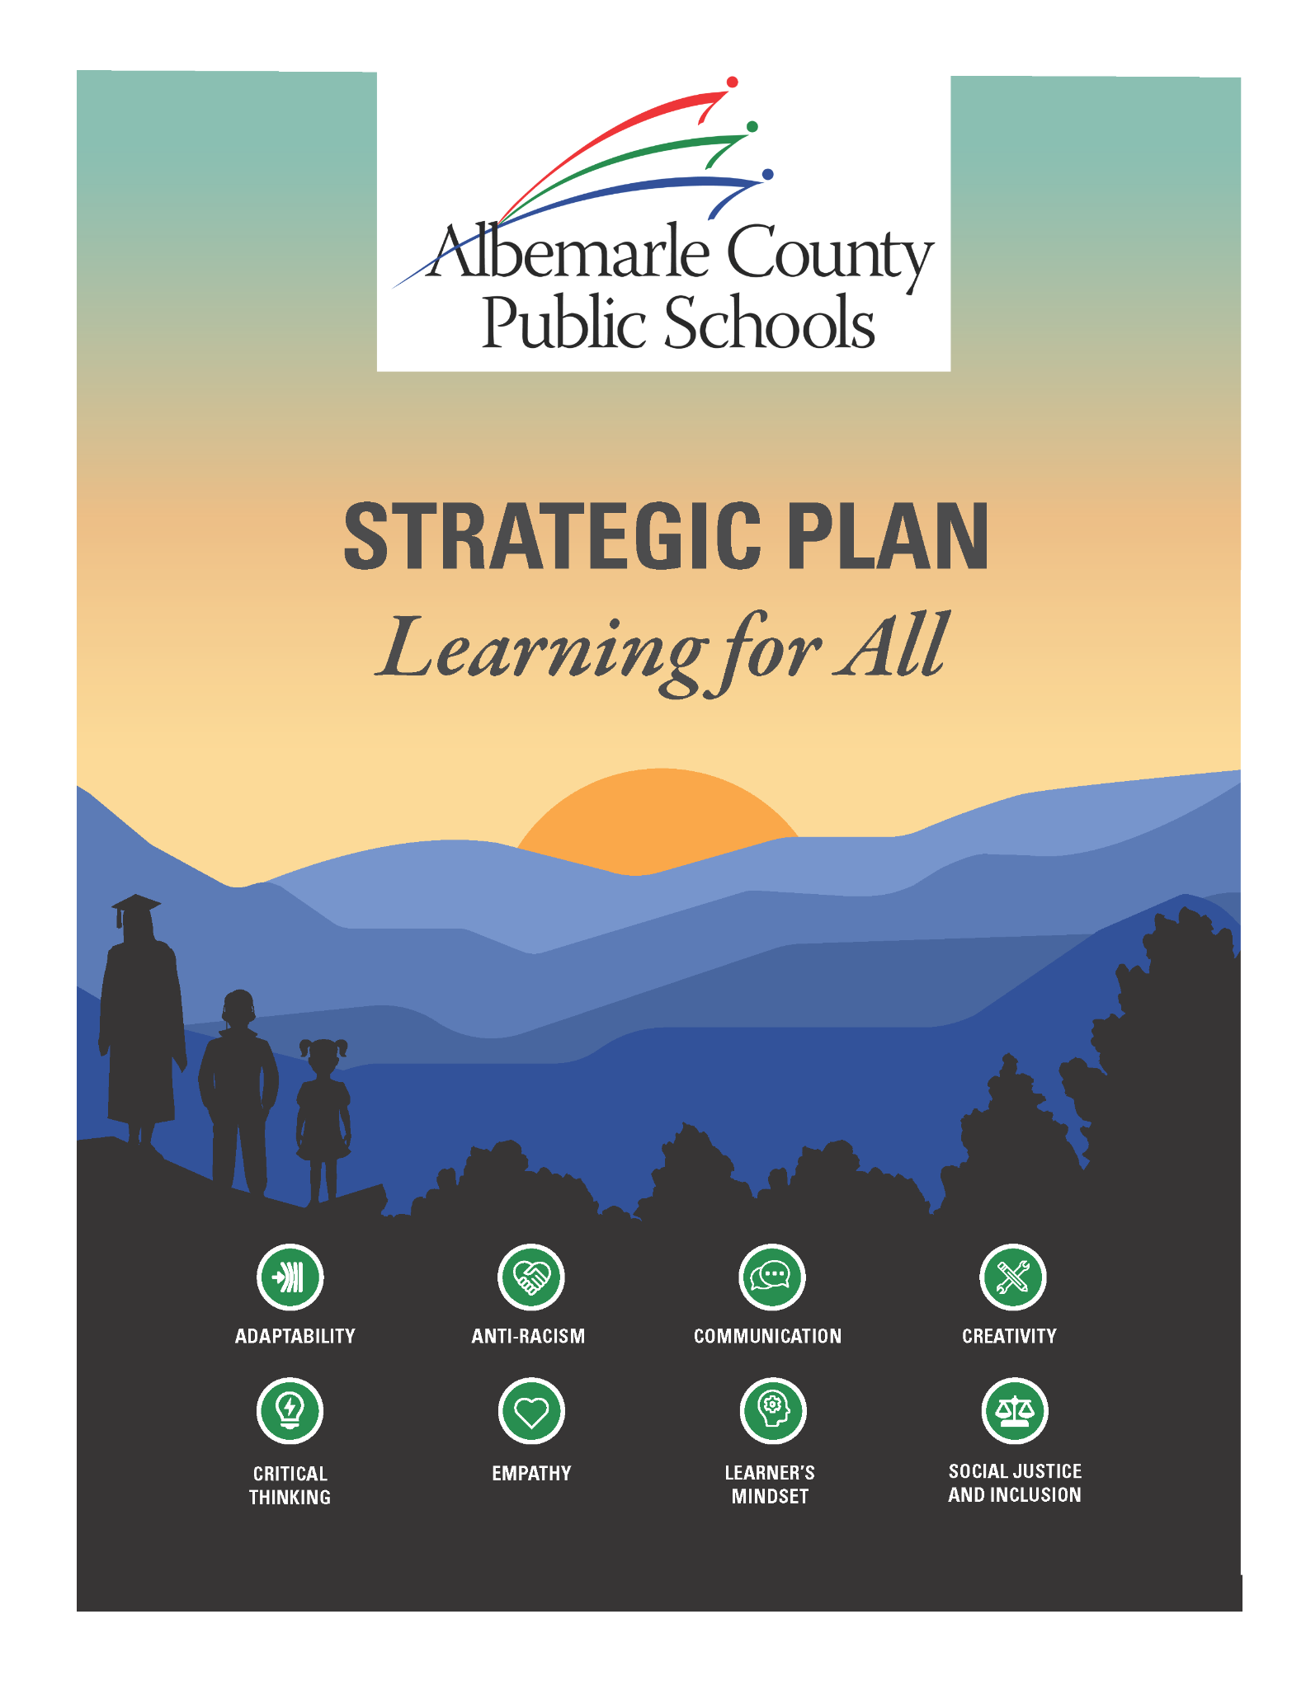
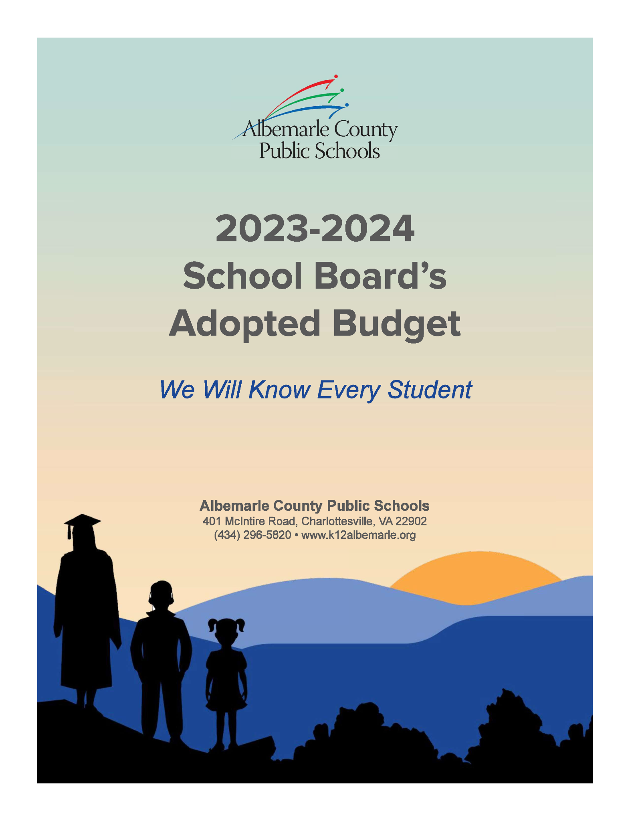

Key Documents for ACPS
LEARNING
FOR ALL
BELLWETHER AUDIT
ANNUAL BUDGET INITIATIVES
Notes:
When we launched the analysis that leads to the 2024 state of the division, we started with these 3 documents.
Learning for all provides the goals and strategies we plan to use to attain our mission and vision.
The Bellwether Audit provides an unbiased look at how well we are doing in the pursuit of these goals and provided research-based recommendations about how we can become more impactful in our pursuit of Learning for All.
Budget Initiatives demonstrate how we are allocating resources in pursuit of Learning for All. After synthesizing these 3 documents, we created 18 Milestones and identified about 30 Metrics.
The next 3 slides share some highlights of Milestones and Metrics within each Goal.

Slide 5
THRIVING STUDENTS
ACPS will facilitate learning experiences grounded in high expectations, networks of care, and student curiosity to ensure academic and social-emotional development for all students while eliminating opportunity, access and achievement gaps.
MILESTONES
Implemented structured literacy curriculum at all school
Completed teacher professional development in two high quality programs to support structured literacy
Exceeded state average for Special Education scores in reading, math, and science
Adopted new elementary and secondary math curriculum
Removed Special Education program from disproportionate federal identification of Black students (intellectual disability) for first time in 25 years
Deepened progress of High School Redesign via Scholars Studios
Notes:
The essence of “thriving students” is providing high expectations coupled with high quality academic and affective supports for the children in our schools.
In the last school year, Milestones included creation of ACPS common pacing guides completely aligned to Virginia Standards of Learning, Implementation of Quarterly Assessments with a focus on reliability and validity in terms of measuring student learning on VA standards, and Launching of All in Tutoring to support students who need additional time and instruction on standards. The last Milestone for this goal I will lift up is ending the year with a systematic adoption process leading to HMH as our literacy program.
In terms of Metrics, we are taking note of initial increases in math and reading achievement as measured by the Virginia Standards of Learning, and the higher percentage of our students graduating on time compared to schools in the rest of Virginia.
Additionally, we noticed our High School course failure rates decreased.
However, we also took note of some metrics we want to be aware of and have worked into our division-level priorities moving forward.
For instance, while HS course failure rates decreased, those for middle school increased.
And, while the percentage of student in the high risk band for VALLS decreased from fall to spring in grades 1-3, we did not hit our target of moving the percentage of students in VALLS high risk bands to under 20%.
It is important to note that while we did adopt HMH at the end of last school year, implementation just is beginning in 24-25 and we foresee the implementation leading to more progress on the decrease in VALLS high risk bands.

Slide 6
THRIVING STUDENTS
ACPS will facilitate learning experiences grounded in high expectations, networks of care, and student curiosity to ensure academic and social-emotional development for all students while eliminating opportunity, access and achievement gaps.
KEY METRICS
Improve Pass Rates on Virginia Standards of Learning (SoL)
75% Reading- higher than state average
74% Math- higher than (3% increase in 23-24)
Science increased
Reduce percentage of students in Virginia Language & Literacy Screening System
(VALLSS) High Risk Category to under 20% for K-3
Kindergarten met goal of under 20%; Grades 1-3 remained above 20%
Course failure rates for MS decreased. Course failure rates for HS increased.
Achieve on-time graduation rates higher than the state
Graduation rate increase from 93.1% to 93.% (at this time, State has not released their rate).
Notes:
The essence of “thriving students” is providing high expectations coupled with high quality academic and affective supports for the children in our schools.
In the last school year, Milestones included creation of ACPS common pacing guides completely aligned to Virginia Standards of Learning, Implementation of Quarterly Assessments with a focus on reliability and validity in terms of measuring student learning on VA standards, and Launching of All in Tutoring to support students who need additional time and instruction on standards. The last Milestone for this goal I will lift up is ending the year with a systematic adoption process leading to HMH as our literacy program.
In terms of Metrics, we are taking note of initial increases in math and reading achievement as measured by the Virginia Standards of Learning, and the higher percentage of our students graduating on time compared to schools in the rest of Virginia.
Additionally, we noticed our High School course failure rates decreased.
However, we also took note of some metrics we want to be aware of and have worked into our division-level priorities moving forward.
For instance, while HS course failure rates decreased, those for middle school increased.
And, while the percentage of student in the high risk band for VALLS decreased from fall to spring in grades 1-3, we did not hit our target of moving the percentage of students in VALLS high risk bands to under 20%.
It is important to note that while we did adopt HMH at the end of last school year, implementation just is beginning in 24-25 and we foresee the implementation leading to more progress on the decrease in VALLS high risk bands.

Slide 7
AFFIRMING & EMPOWERING COMMUNITIES
ACPS commits to developing a culturally-responsive environment that respects and champions the diversity of life experiences of all stakeholders and supports the physical and mental health of our students, staff and families so they are actively empowered to engage in our school community.
MILESTONES
Launched Communities in Schools partnership
Developed and began implementing personal device-free education policy
Established a coordinator of school counseling
Trained staff on Teen Mental Health First Aid
Implemented use of Remind communication platform at all schools
Transitioned to a new division website template intended to improve usability & family and community engagement
Introduced new visitor management system
Increased number of school-based vaccine clinics offered over throughout the year
Notes:
The essence of Affirming and Empowering Communities is acknowledging and supporting all students and their families and communities.
Last year, milestones for this goal included establishing quarterly community engagement nights with an academic focus in all schools, improving communication with families and the community, and maintaining the Socio-Emotional Learning coaches in all schools.
In terms of Metrics for this goal, we are taking note that while we saw an increase in the percentage of staff certified in culturally responsive teaching, that number of 33% still leaves some room for growth in terms of meeting our benchmark.
Given our commitment to the SEL coach budget initiative, we are pleased with school climate, school fit, and family engagement improving on panorama, as well as positive gains in student resilience on DESSA.
That being said, we remain attuned to the need for mental health supports that High School students are expressing and demonstrating both nationally and locally.
Finally, we note that the rates of chronically absent students decreased by 5%.

Slide 8
AFFIRMING & EMPOWERING COMMUNITIES
ACPS commits to developing a culturally-responsive environment that respects and champions the diversity of life experiences of all stakeholders and supports the physical and mental health of our students, staff and families so they are actively empowered to engage in our school community.
KEY METRICS
45% of teachers certified in Culturally Responsive Education (up from 33% in 23-24)
Teacher demographics remained unchanged at 13% people of color. Goal is more closely resemble student diversity (42% of color)
Decreased chronic absenteeism (net decrease of 6% since 22-23)
Increased or maintained positive feelings from community in all three indicators
Notes:
The essence of Affirming and Empowering Communities is acknowledging and supporting all students and their families and communities.
Last year, milestones for this goal included establishing quarterly community engagement nights with an academic focus in all schools, improving communication with families and the community, and maintaining the Socio-Emotional Learning coaches in all schools.
In terms of Metrics for this goal, we are taking note that while we saw an increase in the percentage of staff certified in culturally responsive teaching, that number of 33% still leaves some room for growth in terms of meeting our benchmark.
Given our commitment to the SEL coach budget initiative, we are pleased with school climate, school fit, and family engagement improving on panorama, as well as positive gains in student resilience on DESSA.
That being said, we remain attuned to the need for mental health supports that High School students are expressing and demonstrating both nationally and locally.
Finally, we note that the rates of chronically absent students decreased by 5%.

Slide 9
EQUITABLE, TRANSFORMATIVE RESOURCES
ACPS will attract, develop and retain the highest quality staff; develop sustainable and modern facilities, infrastructure and equipment; and distribute all resources in an equitable manner to transform learning experiences and opportunities.
MILESTONES
Began construction on two new schools and a new data center
Completed collective bargaining elections
Implemented a 3% pay increase for all employees
Launched weapons detection system
Opened two employee health clinics to serve as a low cost option for employees
Started school year with full complement of bus drivers
Notes:
The essence of equitable and transformative resources is meeting the needs of our students and communities.
Last school year, milestones we accomplished for this goal include establishing the Accelerated School program which reconceptualized how we at the division level provided support and accountability for our most challenged schools, improving working conditions for staff such as compensation and collective bargaining, and providing field experiences for not just our k-5 students but also our middle school learners.
The metrics that we are taking note of for this goal are our progress within state accreditation in which we improved to 20 schools earning full accreditation and we are especially encouraged by the 2 schools participating in our Accelerated program moved not only up in state ratings but federal ones as well.
In terms of employee engagement, we see gains in our Gallup survey results. We are also keeping an eye on the capacity levels as we note the increase of 5% in terms of schools at capacity.
Even with these promising accomplishments, we note we have work to do around continuing to deeply support four schools that are accredited with conditions, but our confidence is growing given the way we’ve restructured supports for these school and are in turn seeing initial improvements.

Slide 10
EQUITABLE, TRANSFORMATIVE RESOURCES
ACPS will attract, develop and retain the highest quality staff; develop sustainable and modern facilities, infrastructure and equipment; and distribute all resources in an equitable manner to transform learning experiences and opportunities.
KEY METRICS
19 schools are “Distinguished” (8) or “On Track” (11), which is one less than last year.
Five schools are Off Track.
Preliminary teacher retention rate is holding constant
All K-8 Students participated in 2 field experiences
Employee engagement as measured by Gallup improved .1 on a 5 point scale
Percentage of schools at 95% capacity increased (due to relieving one larger school and distributing to two smaller schools)
Notes:
The essence of equitable and transformative resources is meeting the needs of our students and communities.
Last school year, milestones we accomplished for this goal include establishing the Accelerated School program which reconceptualized how we at the division level provided support and accountability for our most challenged schools, improving working conditions for staff such as compensation and collective bargaining, and providing field experiences for not just our k-5 students but also our middle school learners.
The metrics that we are taking note of for this goal are our progress within state accreditation in which we improved to 20 schools earning full accreditation and we are especially encouraged by the 2 schools participating in our Accelerated program moved not only up in state ratings but federal ones as well.
In terms of employee engagement, we see gains in our Gallup survey results. We are also keeping an eye on the capacity levels as we note the increase of 5% in terms of schools at capacity.
Even with these promising accomplishments, we note we have work to do around continuing to deeply support four schools that are accredited with conditions, but our confidence is growing given the way we’ve restructured supports for these school and are in turn seeing initial improvements.

Slide 11
2024-25 State of the Division
Acknowledgements
Lauren Hunt, Communications Coordinator
Sara Dusenberry, Senior Data Analyst and Reporting Specialist
Karen Heathcock, Curriculum Coordinator, Elementary Language Arts
Craig Dommer, Executive Director, Curriculum, Instruction, Assessment
Darah Bonham, School Safety Coordinator
Megan Wood, Director, Professional Learning
Tony Borash, Assistant Director, Professional Learning
“We will know every student.”
Notes:
I hope you will continue to read and reflect on the larger report and that tonight’s overview has served as an entree into the 2024 state of the division report.
We are happy to take questions at this time.

